Slide 1




Student success
Prediction
Team: Ferguson, Ryan
Haines, Jessica
Kompella, Abhinav
Mikkilineni, Roopesh

Slide 2
Table of contents
Why we chose this topic
Our Dataset
Preprocessing
Models
Conclusions
References

Slide 3
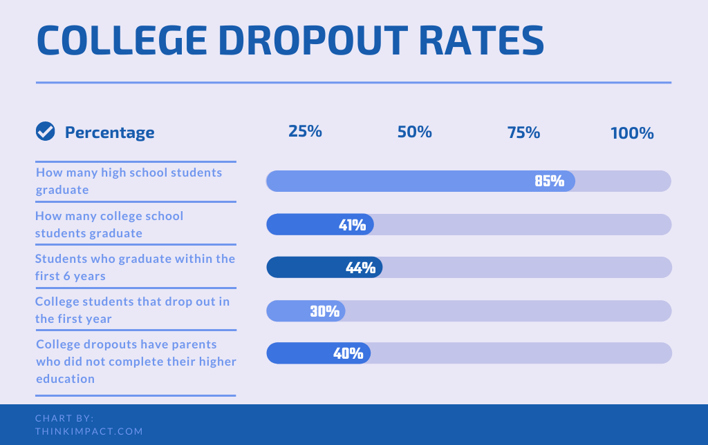
Why we chose this topic
A lot of people dropped this class and this made us think about dropout rates not just for this class, but for school in general.
We thought it would be interesting to see if a model can be made to predict whether or not a student will dropout and decided to focus on college students for our project.

Slide 4
Our Dataset
Dataset: Predict students' dropout and academic success
The data was original gathered by 4 researchers and posted to Zenodo, but was later reformatted and put on Kaggle
4424 rows x 35 columns
No missing values
Target feature is the only categorical feature
3 Targets: Dropout, Graduated, and Enrolled

Slide 5
Our Dataset (cont.)
Columns:['Marital status'] ['Application mode'] ['Application order'] ['Course'] ['Daytime/evening attendance'] ['Previous qualification'] ['Nacionality'] ['Mother's qualification'] ['Father's qualification'] ['Mother's occupation'] ['Father's occupation'] ['Displaced'] ['Educational special needs'] ['Debtor'] ['Tuition fees up to date'] ['Gender'] ['Scholarship holder'] ['Age at enrollment'] ['International'] ['Curricular units 1st sem (credited)'] ['Curricular units 1st sem (enrolled)'] ['Curricular units 1st sem (evaluations)'] ['Curricular units 1st sem (approved)'] ['Curricular units 1st sem (grade)'] ['Curricular units 1st sem (without evaluations)'] ['Curricular units 2nd sem (credited)'] ['Curricular units 2nd sem (enrolled)'] ['Curricular units 2nd sem (evaluations)'] ['Curricular units 2nd sem (approved)'] ['Curricular units 2nd sem (grade)'] ['Curricular units 2nd sem (without evaluations)'] ['Unemployment rate'] ['Inflation rate'] ['GDP'] ['Target']

Slide 6
Preprocessing
We printed out the dataset, a description of the dataset, and a histogram for each column. So we could see the shape of the data.
We decided to round up the ['Curricular units 1st sem (grade)'] and ['Curricular units 2nd sem (grade)'] columns because some of the entries had 13 decimal places while most had no more than 3.
We also decided to reduce the number of targets from 3 to 2 since we are only looking for if they did or did not dropout.
We did this by combining the Graduated and Enrolled targets into one called No_Dropout

Slide 7
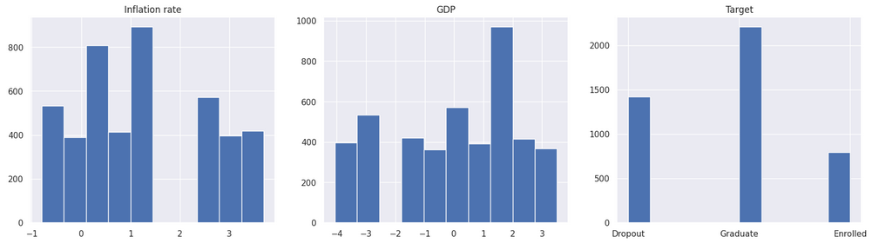
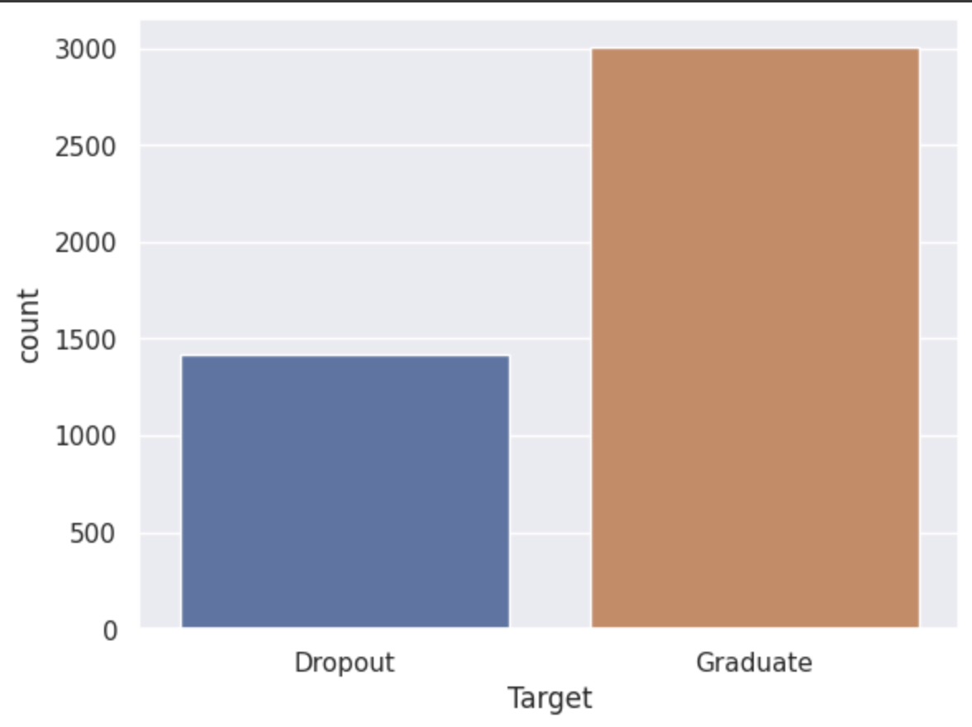
Preprocessing (cont.)

Slide 8
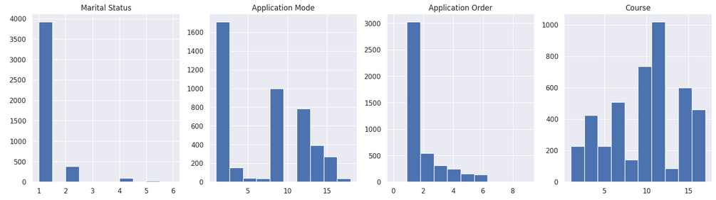
Preprocessing (cont.)

Slide 9
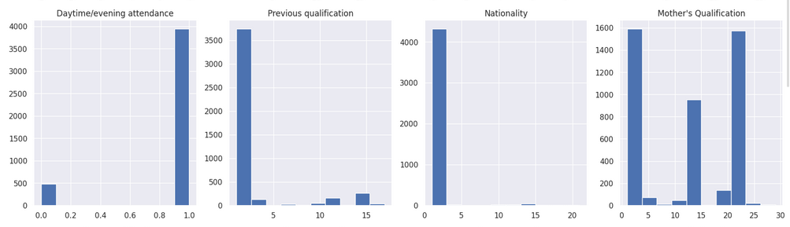
Preprocessing (cont.)

Slide 10
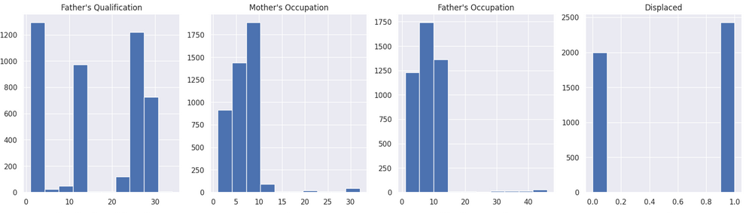
Preprocessing (cont.)

Slide 11
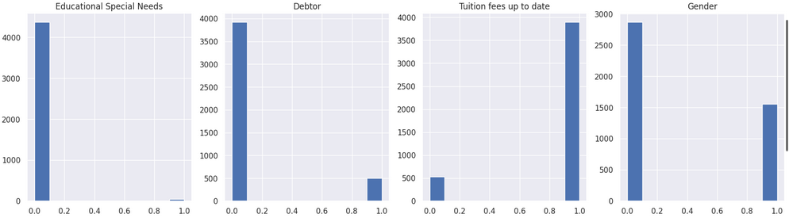
Preprocessing (cont.)

Slide 12
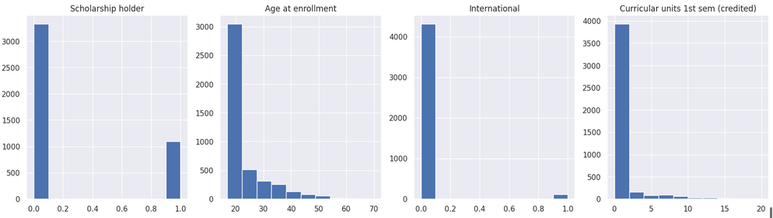
Preprocessing (cont.)

Slide 13
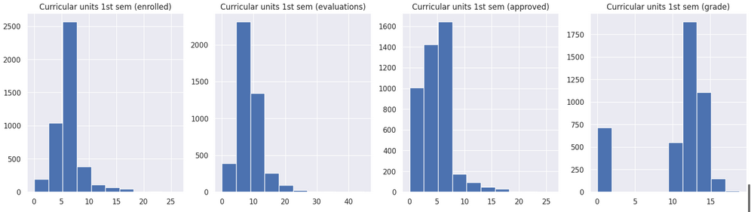
Preprocessing (cont.)

Slide 14
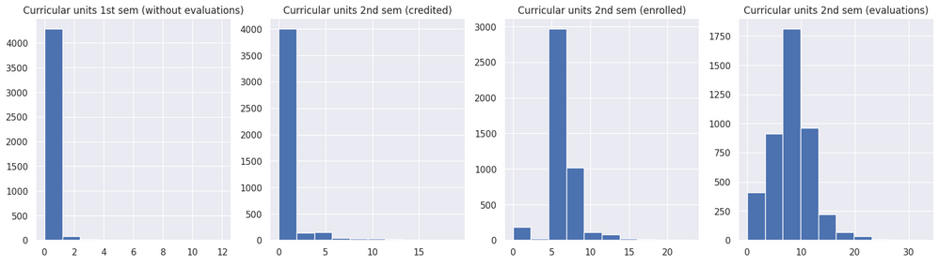
Preprocessing (cont.)

Slide 15
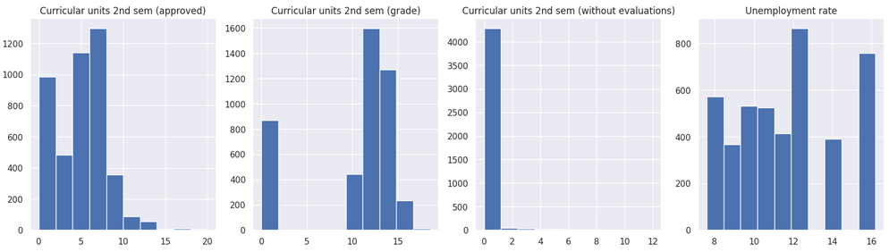
Preprocessing (cont.)

Slide 16
Preprocessing (cont.)

Slide 17
Preprocessing (cont.)
A lot of the features have a skewed distribution but after some testing, we decided to not process the dataset further since models were performing relatively well.
This could definitely be an opportunity for some deeper feature analysis and possible dimension reduction.

Slide 18
Models
Decision Tree
Random Forest
Perceptron
Naive Bayes
Logistic Regression
Linear Regression
SVM-Linear Kernel
SVM-RBF Kernel
Gradient Boosting
Multi-Layer Perceptron

Slide 19
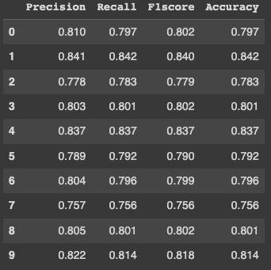
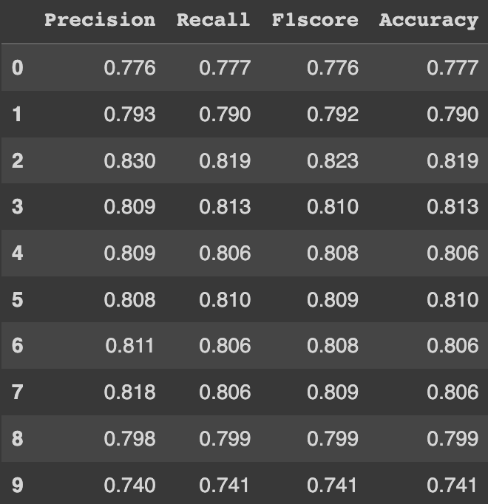
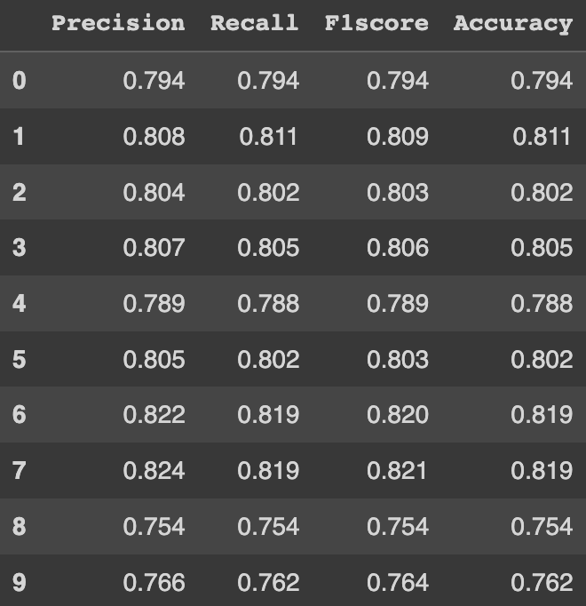
Decision trees
50 - 50 Split
70 - 30 Split
80 - 20 Split

Slide 20
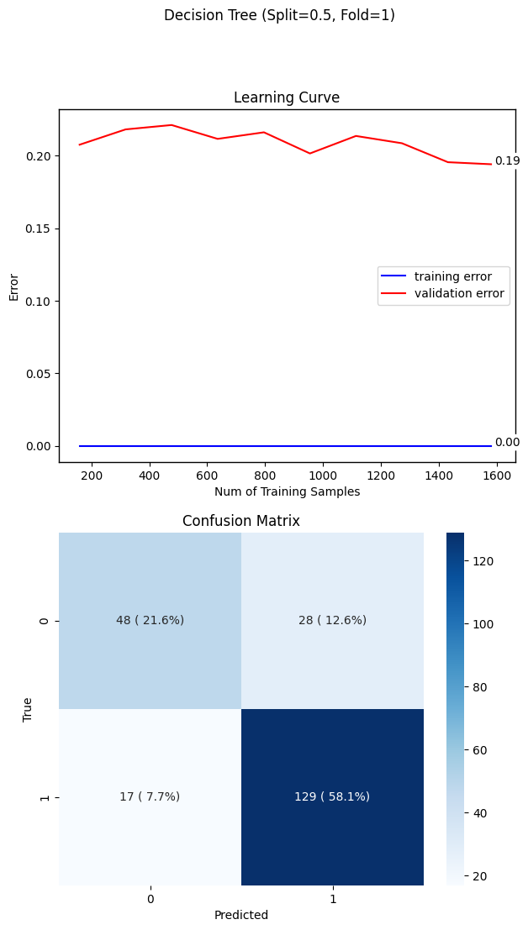

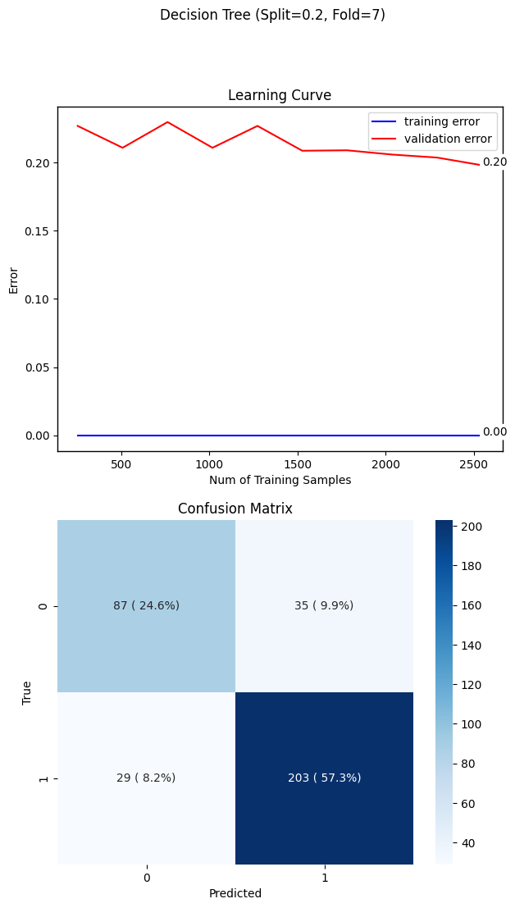
Decision trees
50 - 50 Split
70 - 30 Split
80 - 20 Split

Slide 21
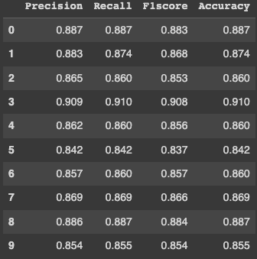
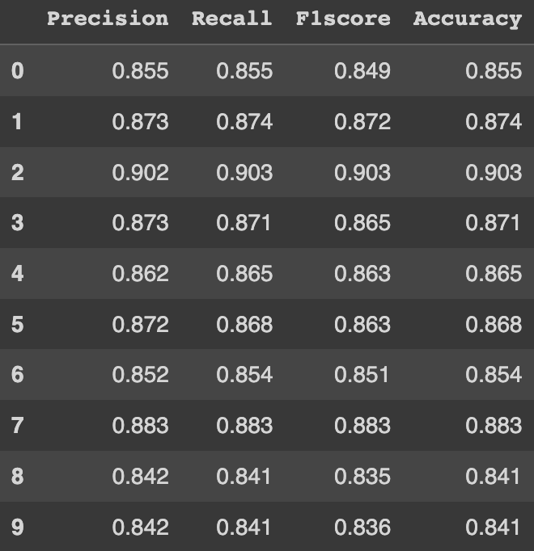
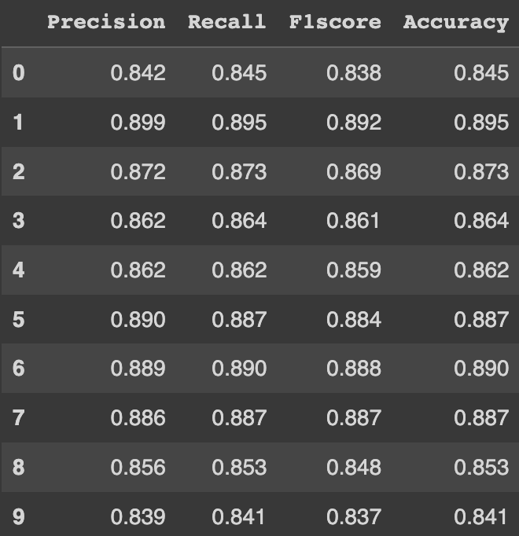
Random Forest
50 - 50 Split
70 - 30 Split
80 - 20 Split

Slide 22
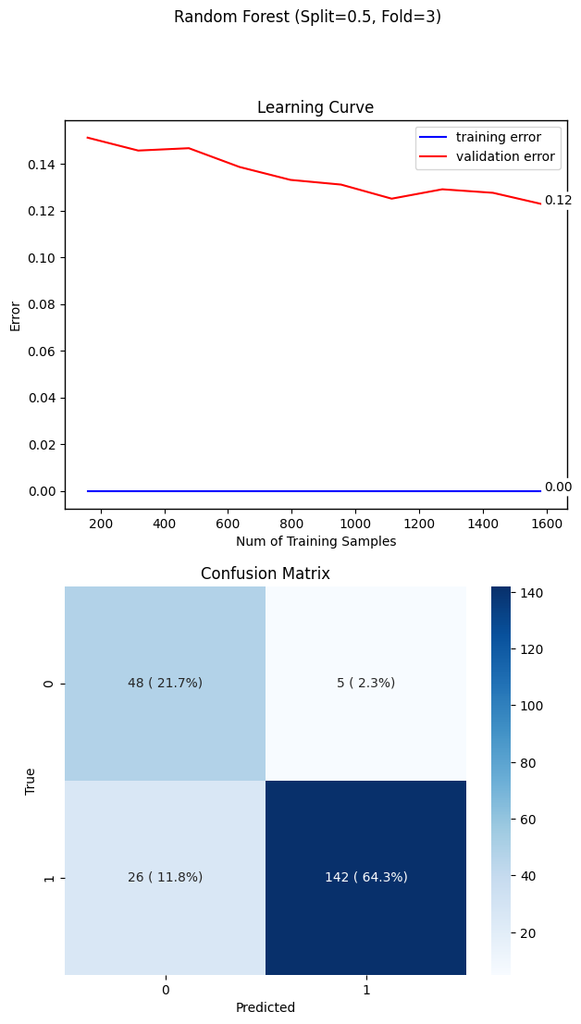
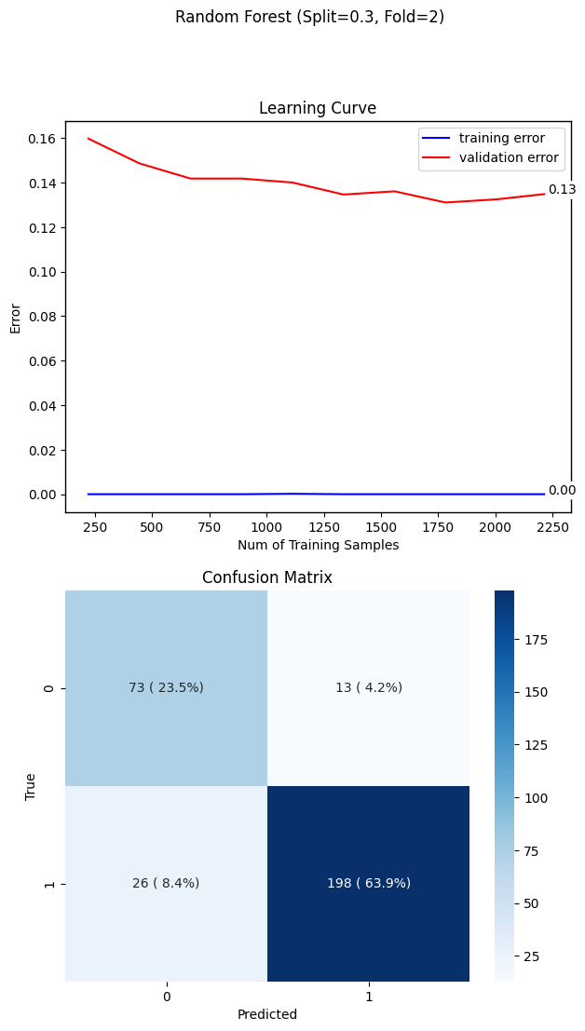

Random Forest
50 - 50 Split
70 - 30 Split
80 - 20 Split

Slide 23
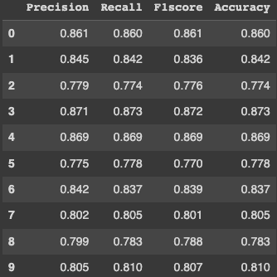
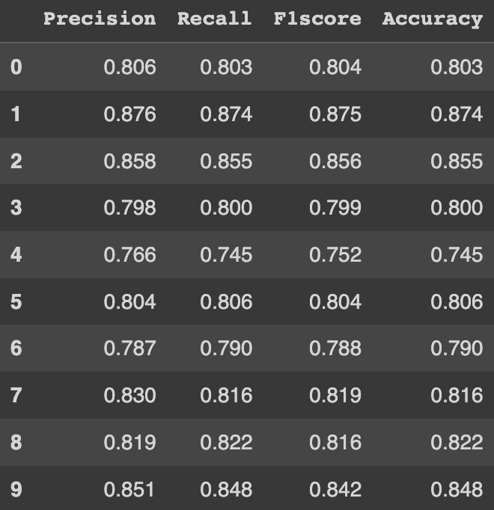
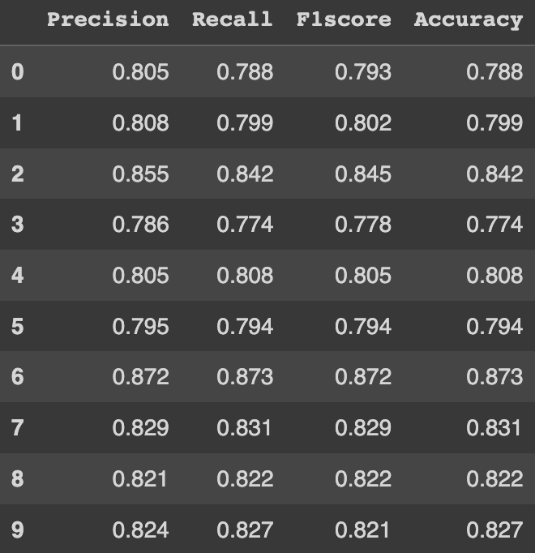
Perceptron
50 - 50 Split
70 - 30 Split
80 - 20 Split

Slide 24
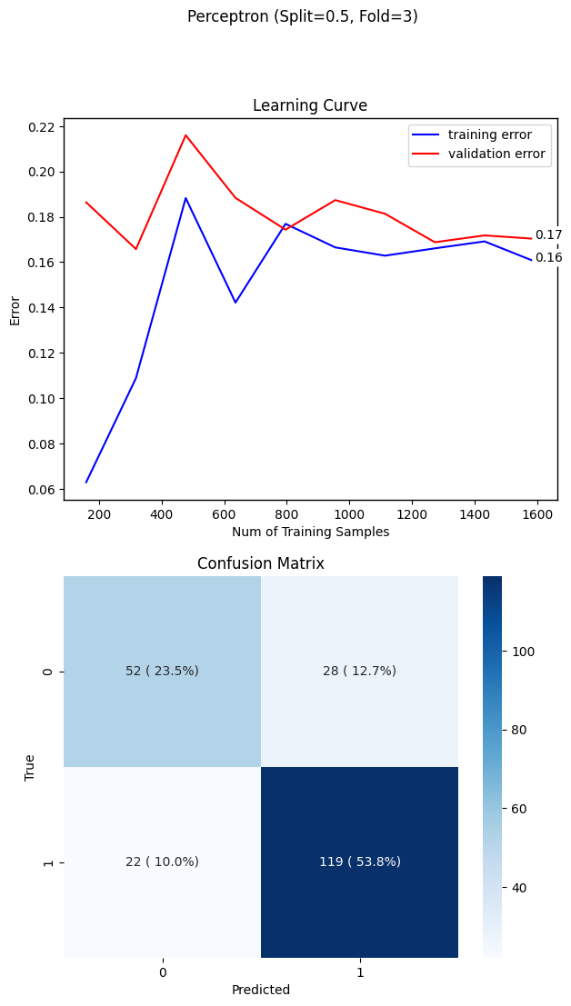


Perceptron
50 - 50 Split
70 - 30 Split
80 - 20 Split

Slide 25
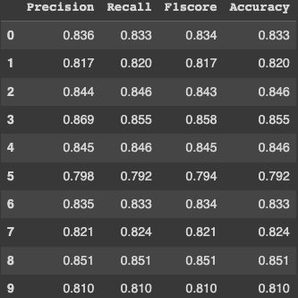
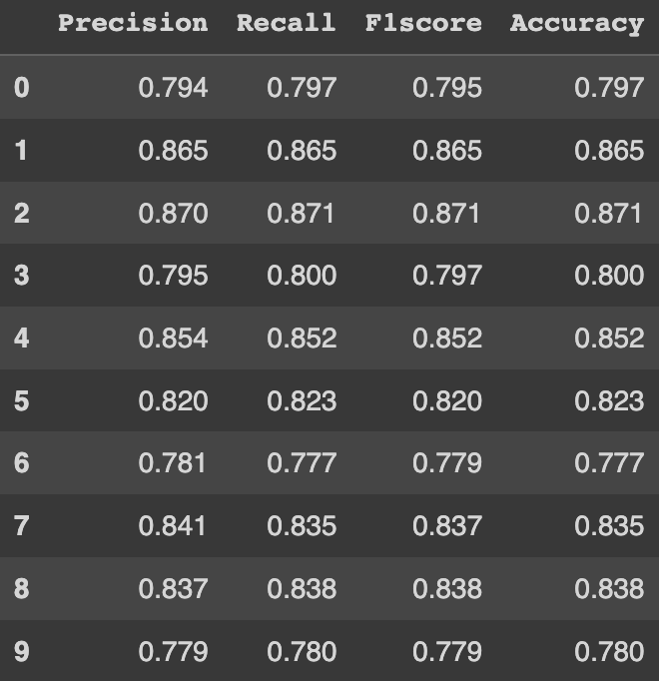
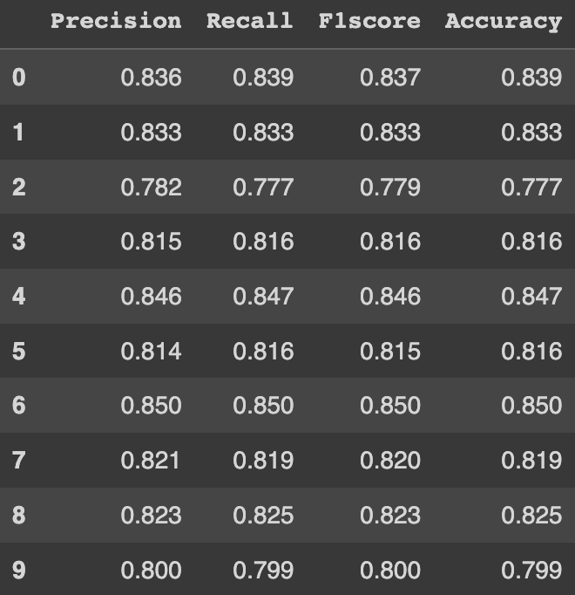
Naive Bayes
50 - 50 Split
70 - 30 Split
80 - 20 Split

Slide 26
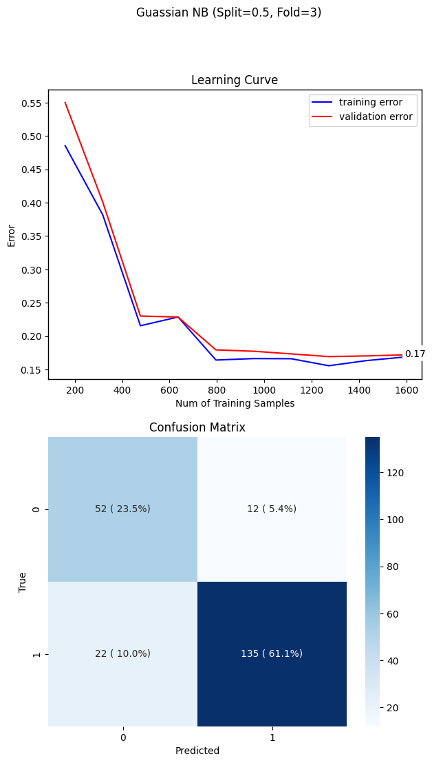
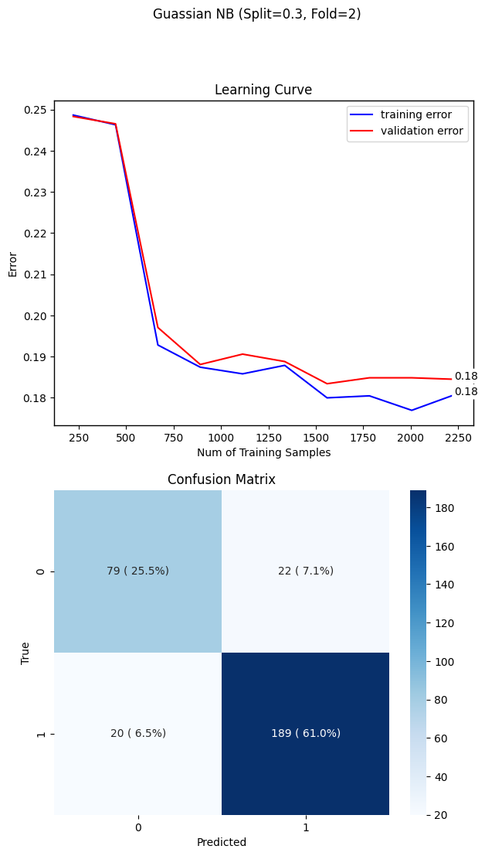
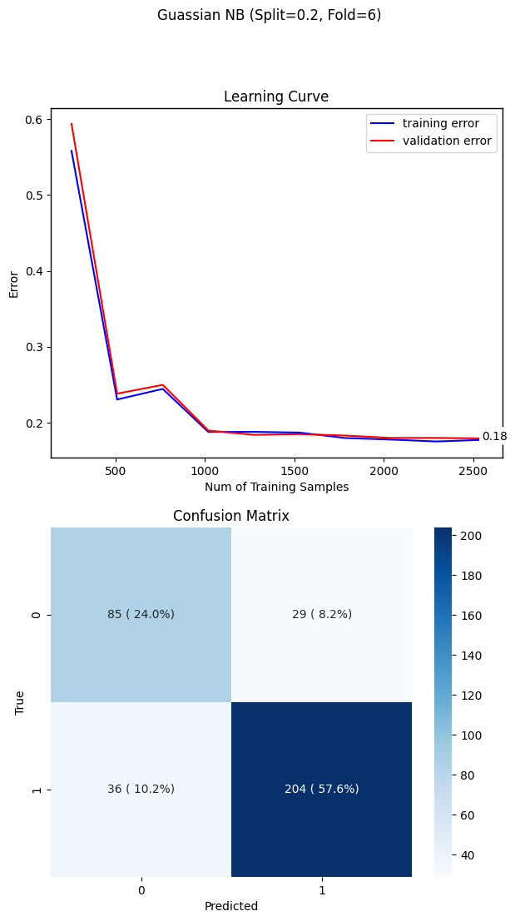
Naive Bayes
50 - 50 Split
70 - 30 Split
80 - 20 Split

Slide 27
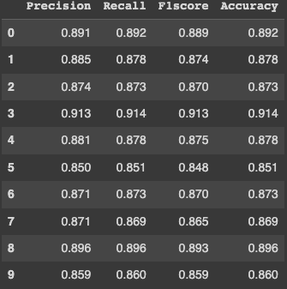
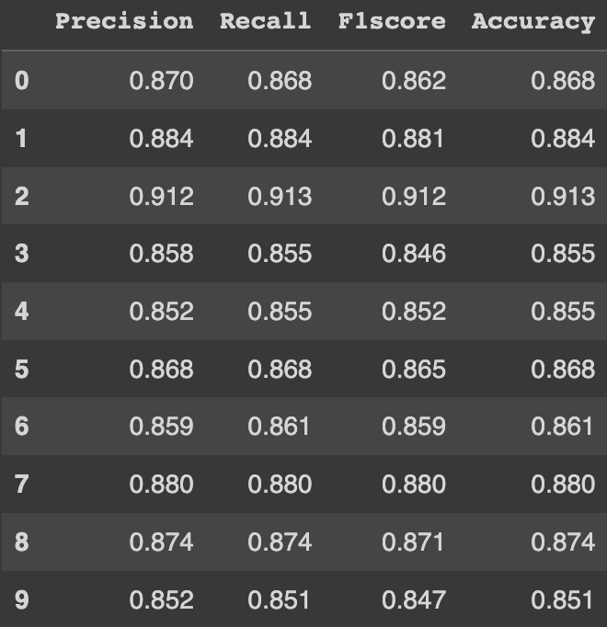
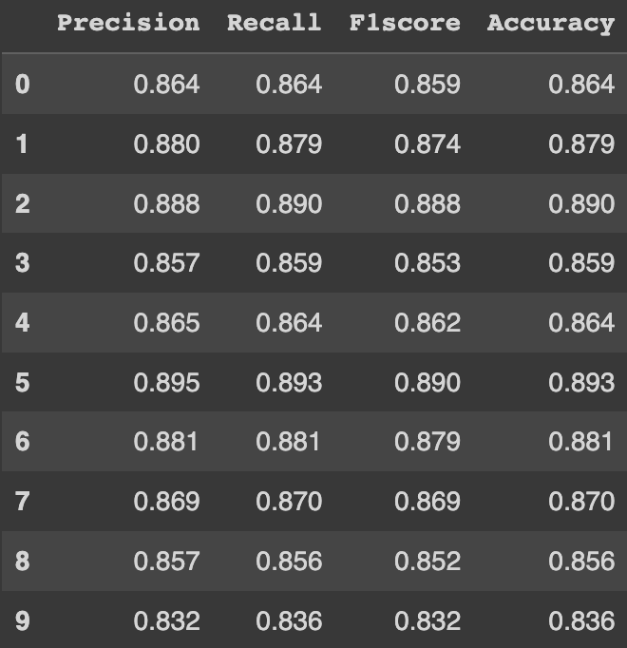
Logistic Regression
50 - 50 Split
70 - 30 Split
80 - 20 Split

Slide 28
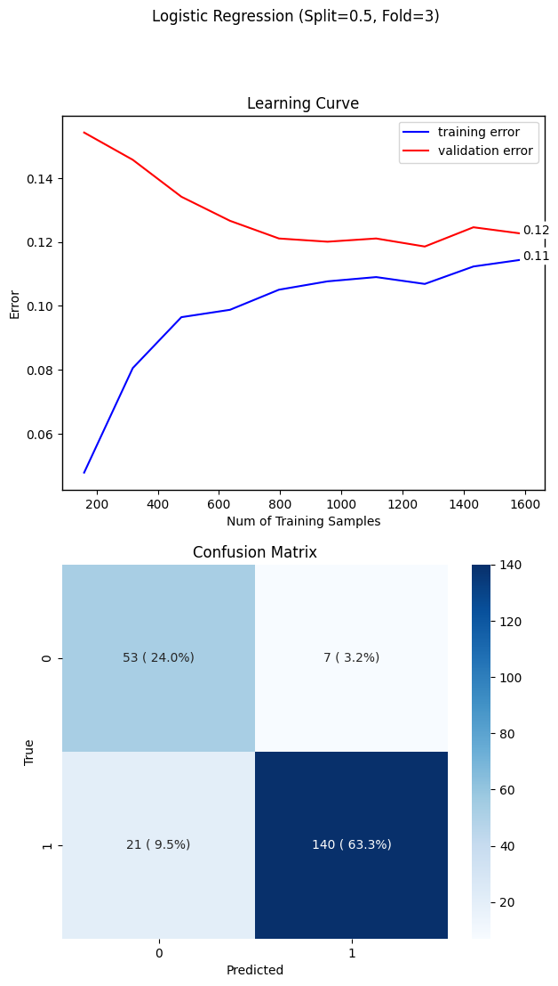
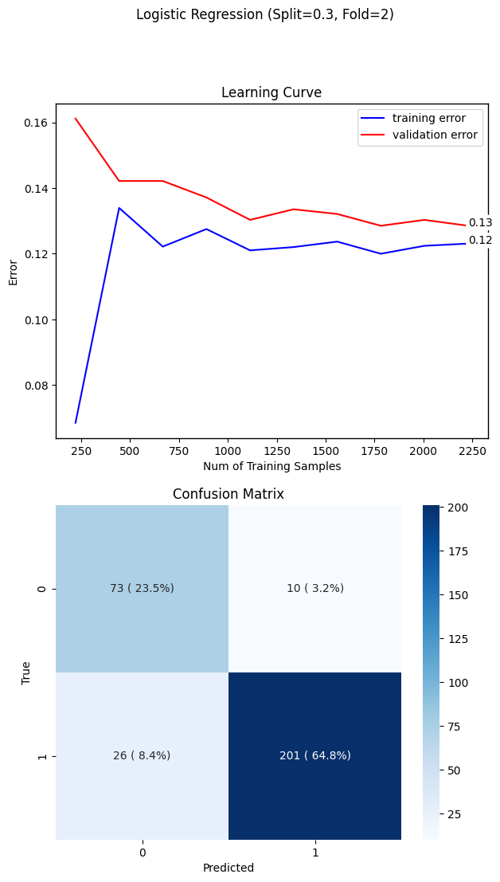

Logistic Regression
50 - 50 Split
70 - 30 Split
80 - 20 Split

Slide 29
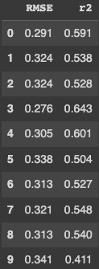
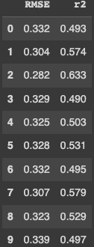
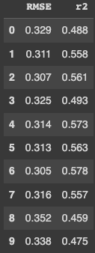

Linear Regression
50 - 50 Split
70 - 30 Split
80 - 20 Split

Slide 30
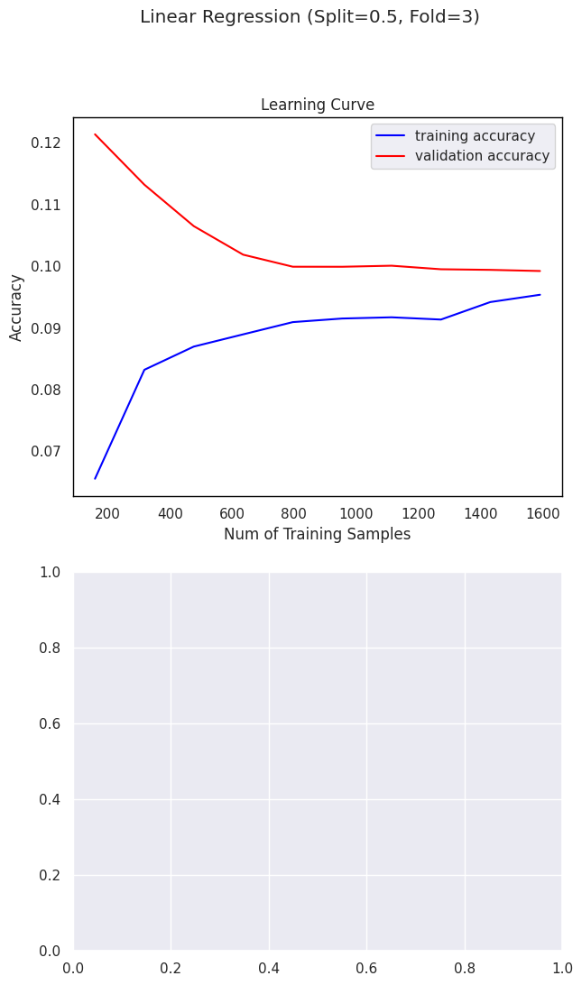
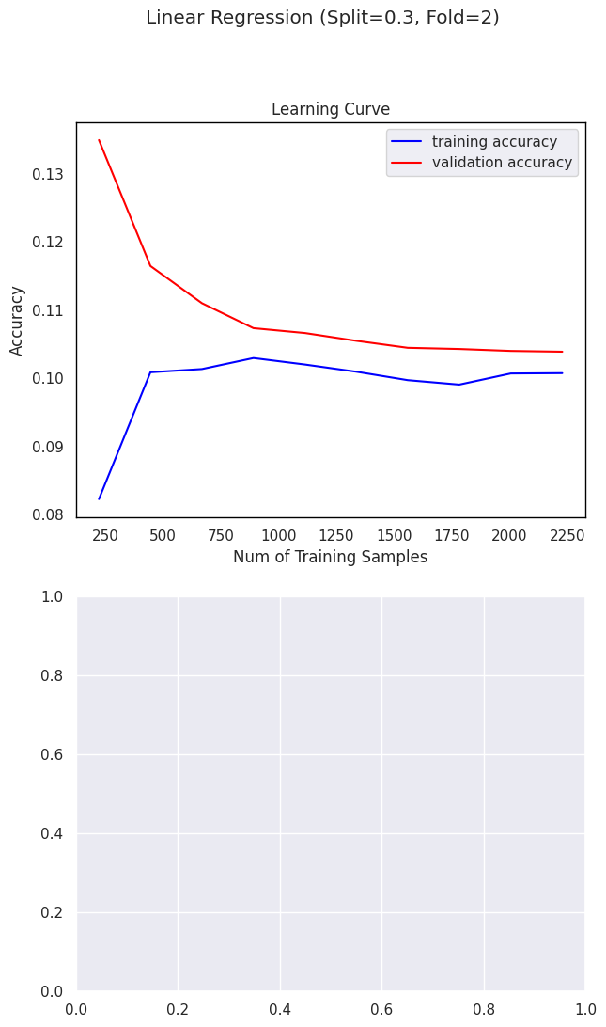
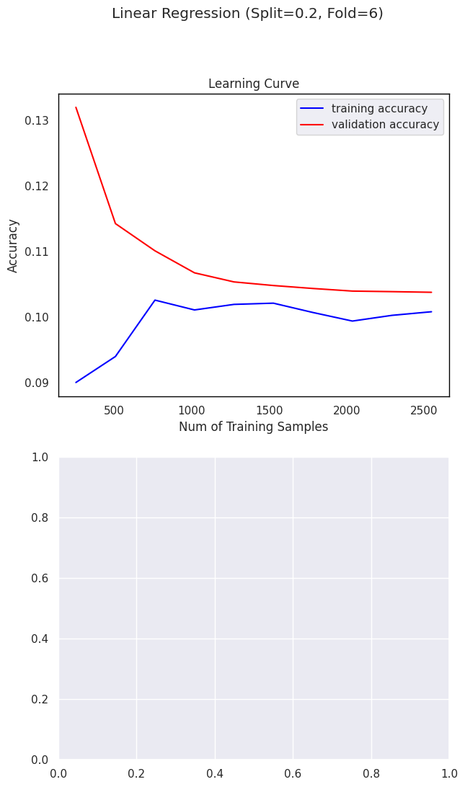
Linear Regression
50 - 50 Split
70 - 30 Split
80 - 20 Split

Slide 31
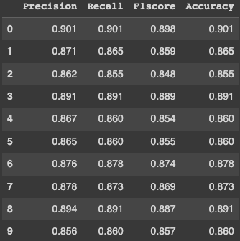
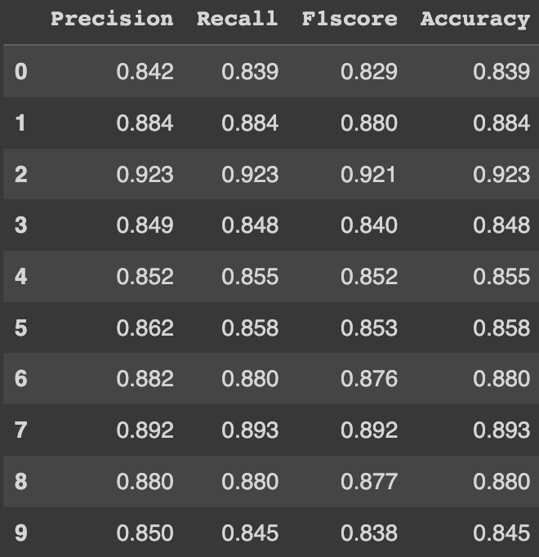
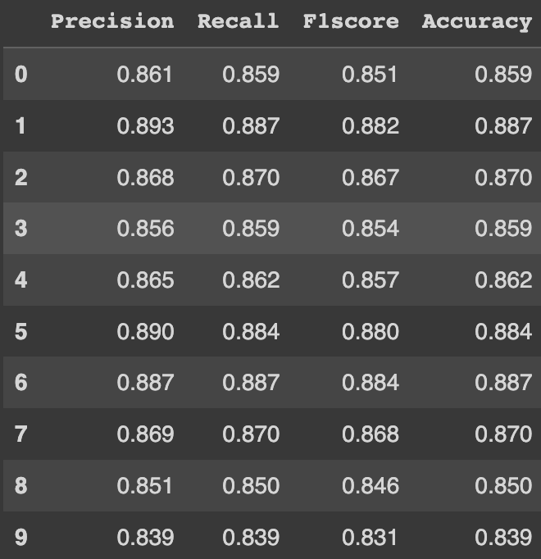
SVM - Linear kernel
50 - 50 Split
70 - 30 Split
80 - 20 Split

Slide 32
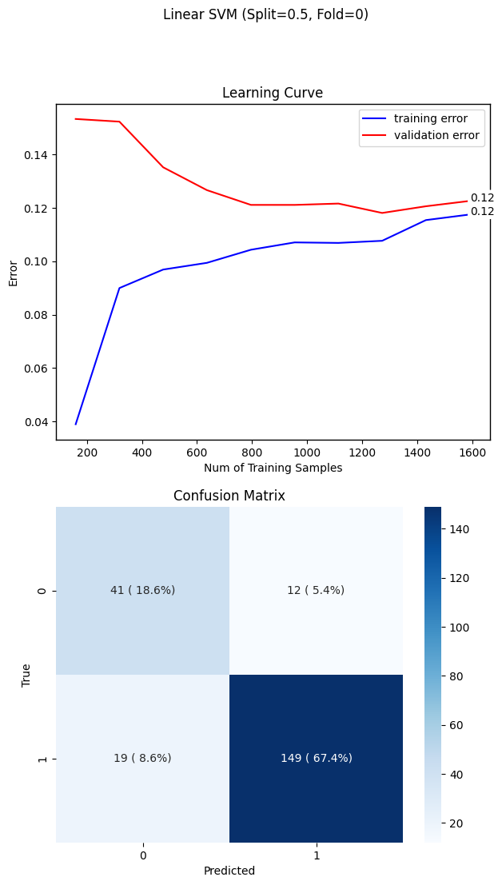

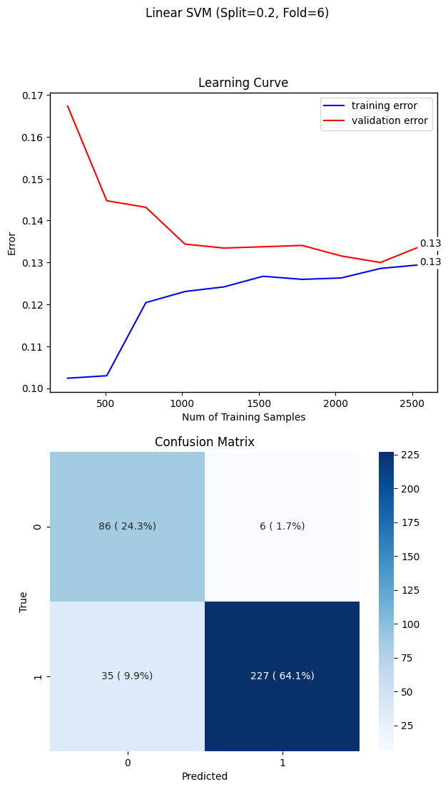
SVM - Linear kernel
50 - 50 Split
70 - 30 Split
80 - 20 Split

Slide 33
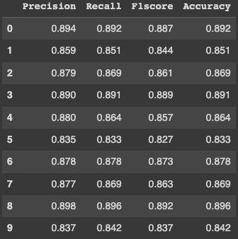
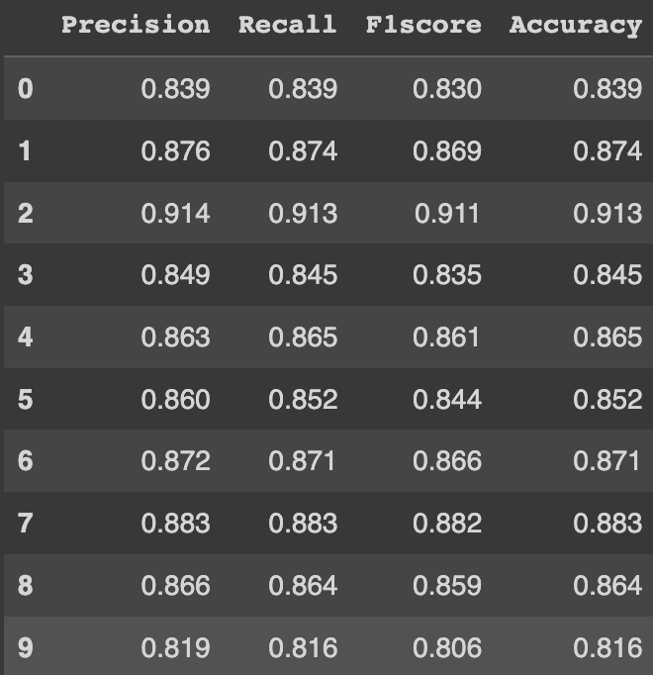
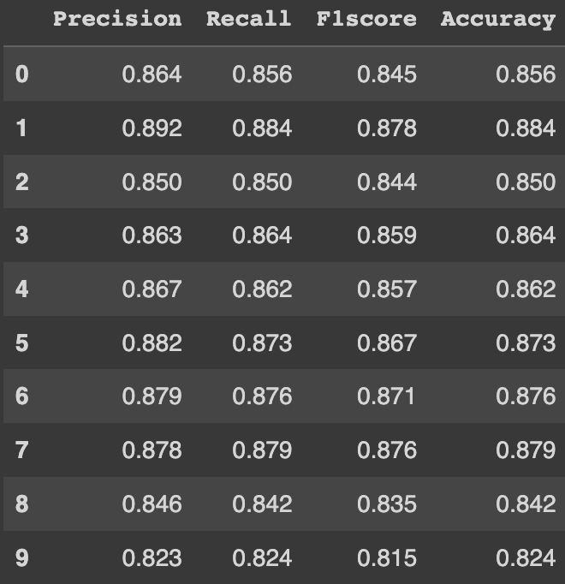
SVM - RBF Kernel
50 - 50 Split
70 - 30 Split
80 - 20 Split

Slide 34



SVM - RBF Kernel
50 - 50 Split
70 - 30 Split
80 - 20 Split

Slide 35



Gradient Boosting
50 - 50 Split
70 - 30 Split
80 - 20 Split

Slide 36



Gradient Boosting
50 - 50 Split
70 - 30 Split
80 - 20 Split

Slide 37



Multi-layer Perceptron
50 - 50 Split
70 - 30 Split
80 - 20 Split

Slide 38



Multi-layer Perceptron
50 - 50 Split
70 - 30 Split
80 - 20 Split

Slide 39

Picking best Model: Naive Bayes vs Log Reg
Gaussian NB (50-50 Split, Fold 3 )
Logistic Regression (50-50 Split, Fold 3 )

Slide 40

Logistic Regression Wins!

Slide 41
Conclusions
Though the Naive Bayes has a ‘better looking’ learning curve plot, the performance metrics barely miss the mark. Logistic Regression has all higher metrics, as well as a lower generalization error, and better confusion matrix.

Slide 42
References
Alsariera YA, Baashar Y, Alkawsi G, Mustafa A, Alkahtani AA, Ali N. Assessment and Evaluation of Different Machine Learning Algorithms for Predicting Student Performance. Computational Intelligence & Neuroscience. May 2022:1-11. doi:10.1155/2022/4151487
Baig, M. A., Shaikh, S. A., Khatri, K. K., Shaikh, M. A., Khan, M. Z. ., & Mahira Abdul Rauf. (2023). Prediction of Students Performance Level Using Integrated Approach of ML Algorithms . International Journal of Emerging Technologies in Learning (iJET), 18(01), pp. 216–234. https://doi.org/10.3991/ijet.v18i01.35339
Valentim Realinho, Jorge Machado, Luís Baptista, & Mónica V. Martins. (2021). Predict students' dropout and academic success (1.0) [Data set]. Zenodo. https://doi.org/10.5281/zenodo.5777340

